Slide 1



Slide 2

Last lecture reminder
We learned about:
Date and Time Python module - properties and methods
Math Python module - properties and methods
Random Python module - properties and methods
String data type - properties and methods
split() method
lower() / upper() methods
find() method
format() method
Different ways to concatenate strings with Python

Slide 3
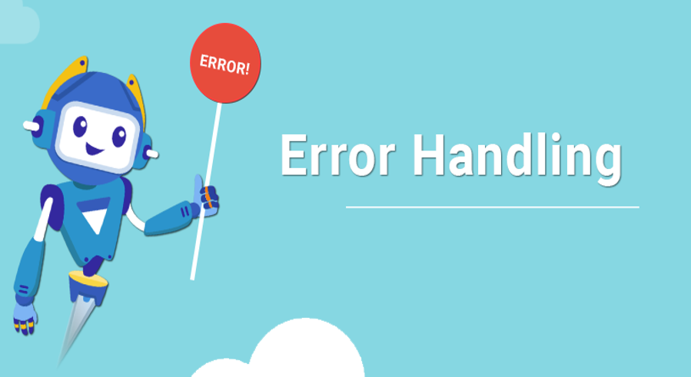

Slide 4
What is an error?
As a developer we can distinguish between 2 types of errors
Business logic errors - errors that occurred due to wrong logic we implemented. For example - our code returned the student last exam grade while according to the Business logic it should have returned the student exam average.
Code errors - errors that occured due to wrong syntax or wrong use of the code. For example - try to call a variable without annonce it first.
When we talk about error handling, most of the cases we are talking about handling with code errors, but we can apply this approach on Business logic errors as well.

Slide 5
Python Error() object
Every time we see an error during our code execution, behind the scene the Interpreter is generating an Error() object. Like every other object in python, the error object also has its own properties and methods. The most useful error property is the message property:
The message property - specify the message that this error holding. Error messages are useful to let the application user / developer more information about the cause for the error. We can have errors without messages but this is not recommended to do.

Slide 6
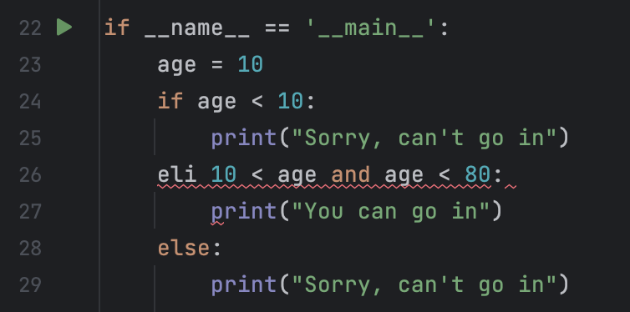
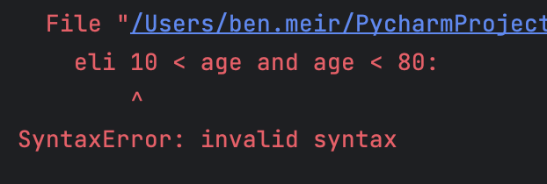
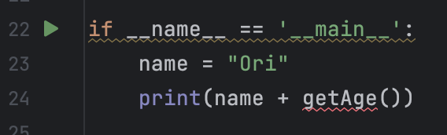
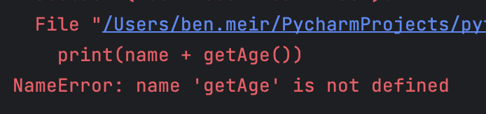
Python error types
Syntax Error - occurred when we write non appropriate Python exprecition
Name Error - occurred when we try to call a non-existent variable or function
Invalid elif type
we try to call getAge() function which is not defined

Slide 7
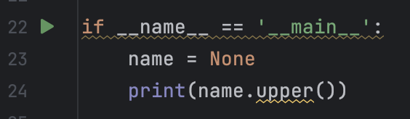
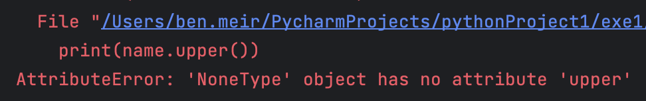
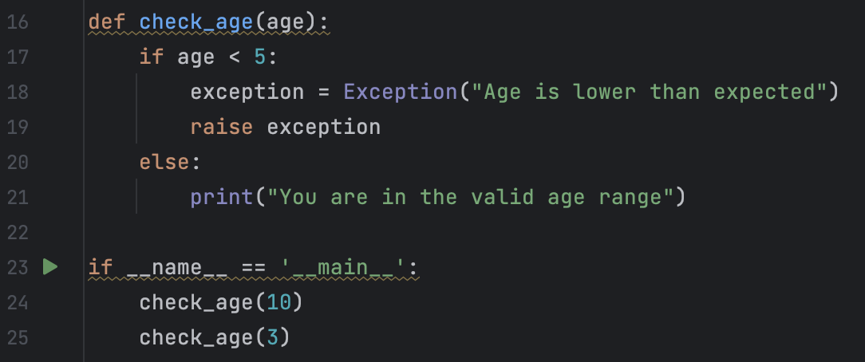
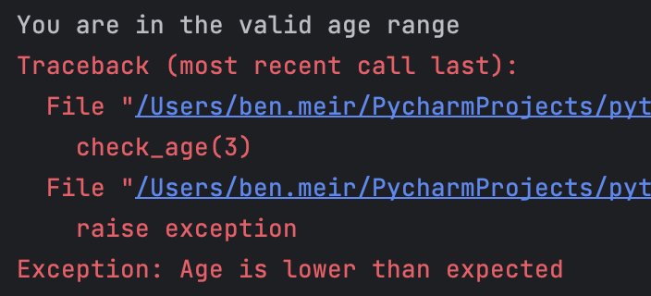
Python error types
Attribute Error - occurred when we try to call an undefined property or method
Custom Error - We can create our own error using the Exception() object and the raise keyword
We try to call upper() method on None variable

Slide 8
How should we apply error handling?
Error handling is basically how we want to handle the errors that we might get in our code. By handling those errors, we notify the interpreter not to fail the execution of the code. Instead we are giving it the commands that we want to run in case of an error.
Error handling syntax:
In order to apply error handling on our code we need to use the try and except Python keywords.
Try - we should put in the try block all the code that we think might cause an error. We basically are telling the interpreter “try” to run this code.
Except - inside the except block we are putting the code we want the interpreter to execute incase of an error that happened in the “try” block. Right after the catch keyword we are saving a pointer to the error we catched so we can have a reference to it.

Slide 9
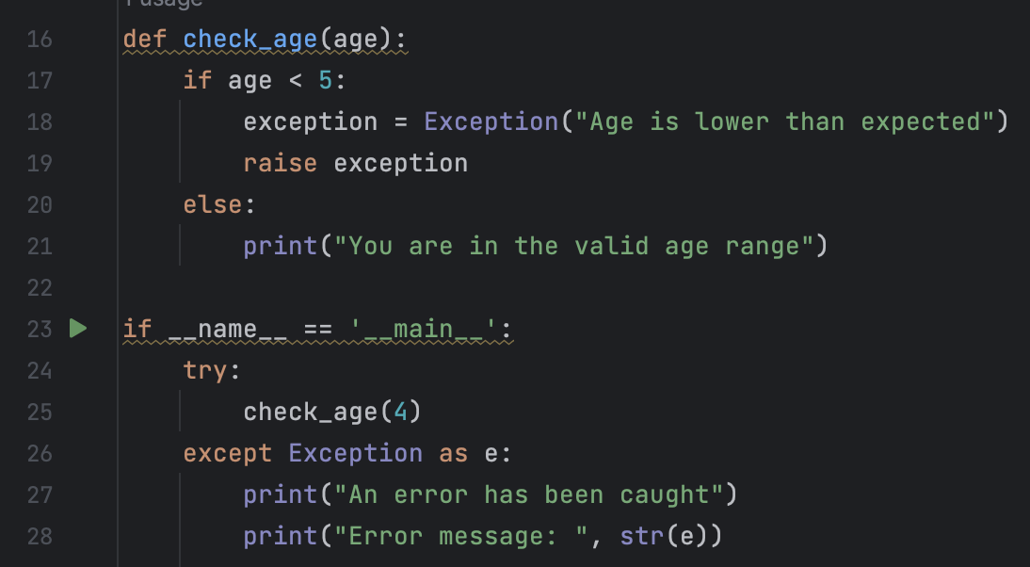
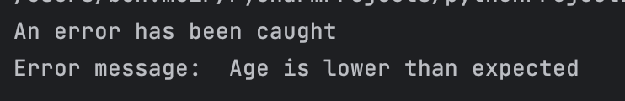
Error handling syntax - Example
For the error handling example let's use our checkAge() function. As described in the code, this function will generate a custom error if the age parameter will be less than 5.
Inside the try block we are putting the code that may cause an exception
Inside the exception block we are putting the code we want the program to execute in case it catched an exception

Slide 10
The finally Keyword
The finally statement lets you execute code, after try...except, regardless of the result. Meaning that the block inside the finally statement will be always executed.
try: // Block of code to try except Exception as e:
// Block of code to handle errors
finally:
// Block of code that always be executed
}

Slide 11
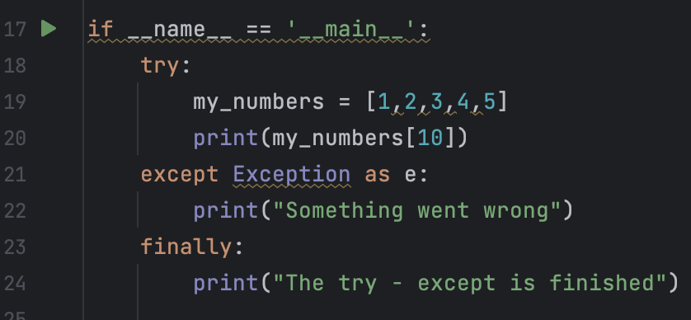
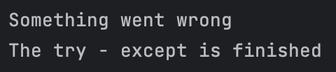
The finally Keyword Example
}
When executing this program, the code inside the finally block will always be executed, regardless the try..except result

Slide 12
When should we use error handling?
Not every time we will want to handle our errors since errors are good indicator that we have a problem in our code.
What is the best practice to use error handling:
We have a specific use case that required from us to handle exceptions.
We have a useful logic to handle it rather then just throw it back to the client.

Slide 13


Slide 14
Introducing Python Lambda Function
Lambda functions in Python are performing just like regular functions but allow us to write shorter function syntax.
We can chose to use lambda functions or regular functions, regarding performance there is no difference at all between them.
Even if you only chose to use regular function it's still important to understand how lambda functions are working because it's most likely that you will see lambda functions in others code or online. Note: Lambda function can’t execute comlex code involving conditions so if you need conditions in your function logic you should use regular functions only.

Slide 15
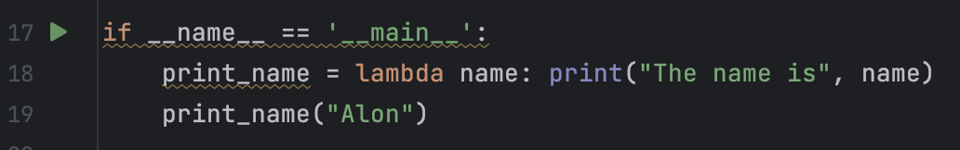

Lambda function syntax
In order to create an arrow function we just need to use this pattern:
Unlike regular functions, with lambda functions we don’t need to use the function keyword and we don't have to define the function name. With lambda functions we just need to mention the function parameters, and the operation we want to perform on those parameters.
lambda {parameter 1}, {parameter 2} : {Operation}
We declaring a lambda function with 1 parameter called “name” and assign it to variable
By calling the variable we created we can execute our arrow function

Slide 16
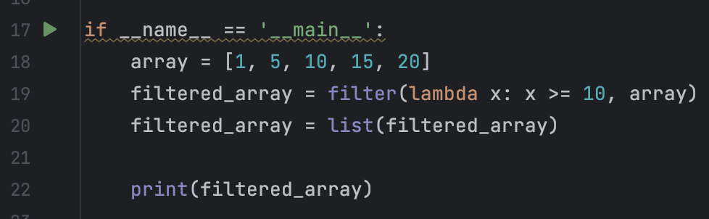

Filter Array using lambda function
Lambda functions can be useful in case we want to perform filtering operation on array. Once we use the filter() function we can pass as parameter lambda function as the filter logic we want to apply on the array elements. For example - Filter all array elements above 10:
We provide to the filter() function lambda function as parameter.

Slide 17
Class Exercise -
Error Handling & Arrow Functions

Slide 18

Class Exercise - Error Handling
Instructions:
You are managing a shopping website, each customer that want to shop need to pass the name of the product that he wants.
In your storage you have a dictionary contain all the product names as keys and the amount you have from them in the stock as the value. For example: { “banana” : 10, orange: 25 }
Your program should handle all the buy requests from the customers.

Slide 19
Class Exercise - Error Handling
Instructions:
Your mission is to implement all the following instructions:
Create the storage dictionary with at least 5 items that are available to buy in your shop.
Create a buy_item() function that allow your customers to buy the items inside your storage dictionary. Note that your customers can buy more then 1 unit from the same item.
Everytime an item being bought you should reduce its amount from the storage.
You should apply error handling and throw custom errors when:
The customer request an item that is not appear in the storage
The customer request to buy more units than you have in your storage
Your program should catch every error and print the error message

Slide 20
Class Exercise -
Error Handling & Arrow Functions Solution

Slide 21


